Slide 1
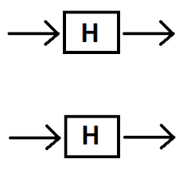

QuantumLecture 8.11 Early Quantum Algorithms & an artificial Intelligence challenge and a strong QC example

Slide 2
Agenda for Lecture 8.11
8:30 – 9:00 RECAP/Exam questions con’t
9:15 – 10:00 Tell us loosely about your 5p. report
10:15 – 11:00 The Double Hadamard
11:00 – 11:45 Challenge part 1
11:45 – 12:30 Lunch
12:30 – 13:15 Challenge part 2
13:30 – 14:00 Abraham Asfaw EP 6 You Try it by Yourself ☺

Slide 3
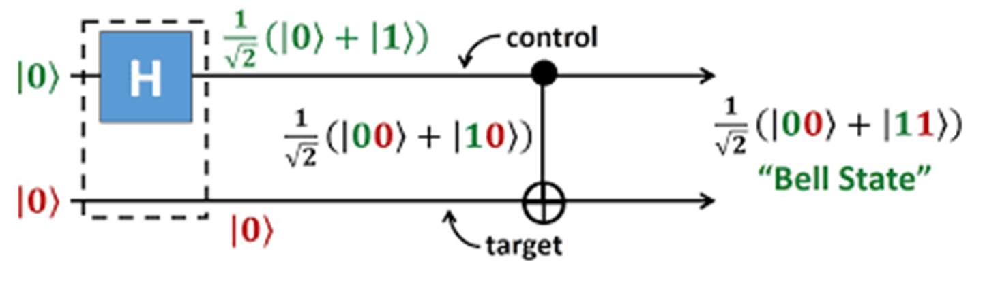
8:30 – 9:00 RECAP
We finish primarily the topics that our exams should contain.
What would You like that we should repeat or emphasize during this course
Recap below ?

Slide 4
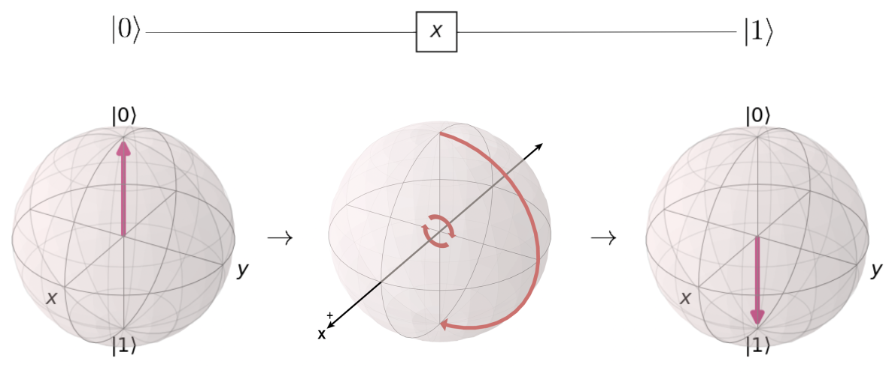
Exercise recaps
What is measurement about
What does the X,Y and Z do as OPERATORS

Slide 5
Pauli X-gate

Slide 6
Pauli Z-gate

Slide 7
Pauli Y-gate

Slide 8
RECAP questions
|χ> = α|0> + β|1>
What is the wavefunction here ?
How many Qubits are involved above ?
How does a wavefunction for two qubits look like ?
How many dimensions in the Hilbert space are there for 1 and 2 qubits respectively ?

Slide 9
9:15 – 10:00 I
Tell us loosely about your 5p. Report
Do it in a manner You feel most comfortable with

Slide 10
10:15 – 11:00 The Double Hadamard
The basic part of all Quantum Algoritms
You try to program in series (Q.U.E. 198-99)
You try to program in parallel (Q.U.E. 198-99)
Video Lecture 8.1 Fourier Sampling

Slide 11
11:15-11:30 The AI-Challenge
SVM explained https://www.youtube.com/watch?v=Y6RRHw9uN9o
SVM with a classical RBF kernel: multiclass classifier extension¶
https://quantum-computing.ibm.com/jupyter/tutorial/advanced/aqua/artificial_intelligence/qsvm_classification.ipynb
Or try by example in theCodeRanch folder
Describe explicit what happens in each codeline
Note codelines that You don’t understand
What would You do to solve point 2 problems ?

Slide 12
The AI Challenge Implementation of Quantum SVM Using the Qiskit library
https://medium.com/datadriveninvestor/implementation-of-quantum-svm-using-the-qiskit-library-9eabb6a6270a
The code as Agustin Bignu talks about at GitHub:
abignu/TFG.

Slide 13
11:45 – 12:30 Lunch &/or Free for the rest of the day

Slide 14
12:30-13:00 The AI-Challenge continued - part 2
Try get the code running ☺

Slide 15
13:15 – 14:00 The Cahallenge part 3
Abraham Asfaw Video EP 6
https://www.youtube.com/watch?v=sqJIpHYl7oo&t=17s
You try to implement it ☺

